Slide 1
Computer Network Lab Introduction of Lab 5
5/5/2021
王智彬

Slide 2
Lab 3-5: Router
Lab 3: Respond to ARP | ✔
Lab 4: Forwarding Packets | ✔
Lab 5: Respond to ICMP

Slide 3
ICMP
Internet Control Message Protocol (RFC 792)
Transfer of error and control msgs among routers and hosts
Echo request and reply to facilitate diagnostic
Feedback about problems, e.g. time to live expired, unreachable host
Encapsulated in IP datagram
Protocol type = 1
Not reliable

Slide 4
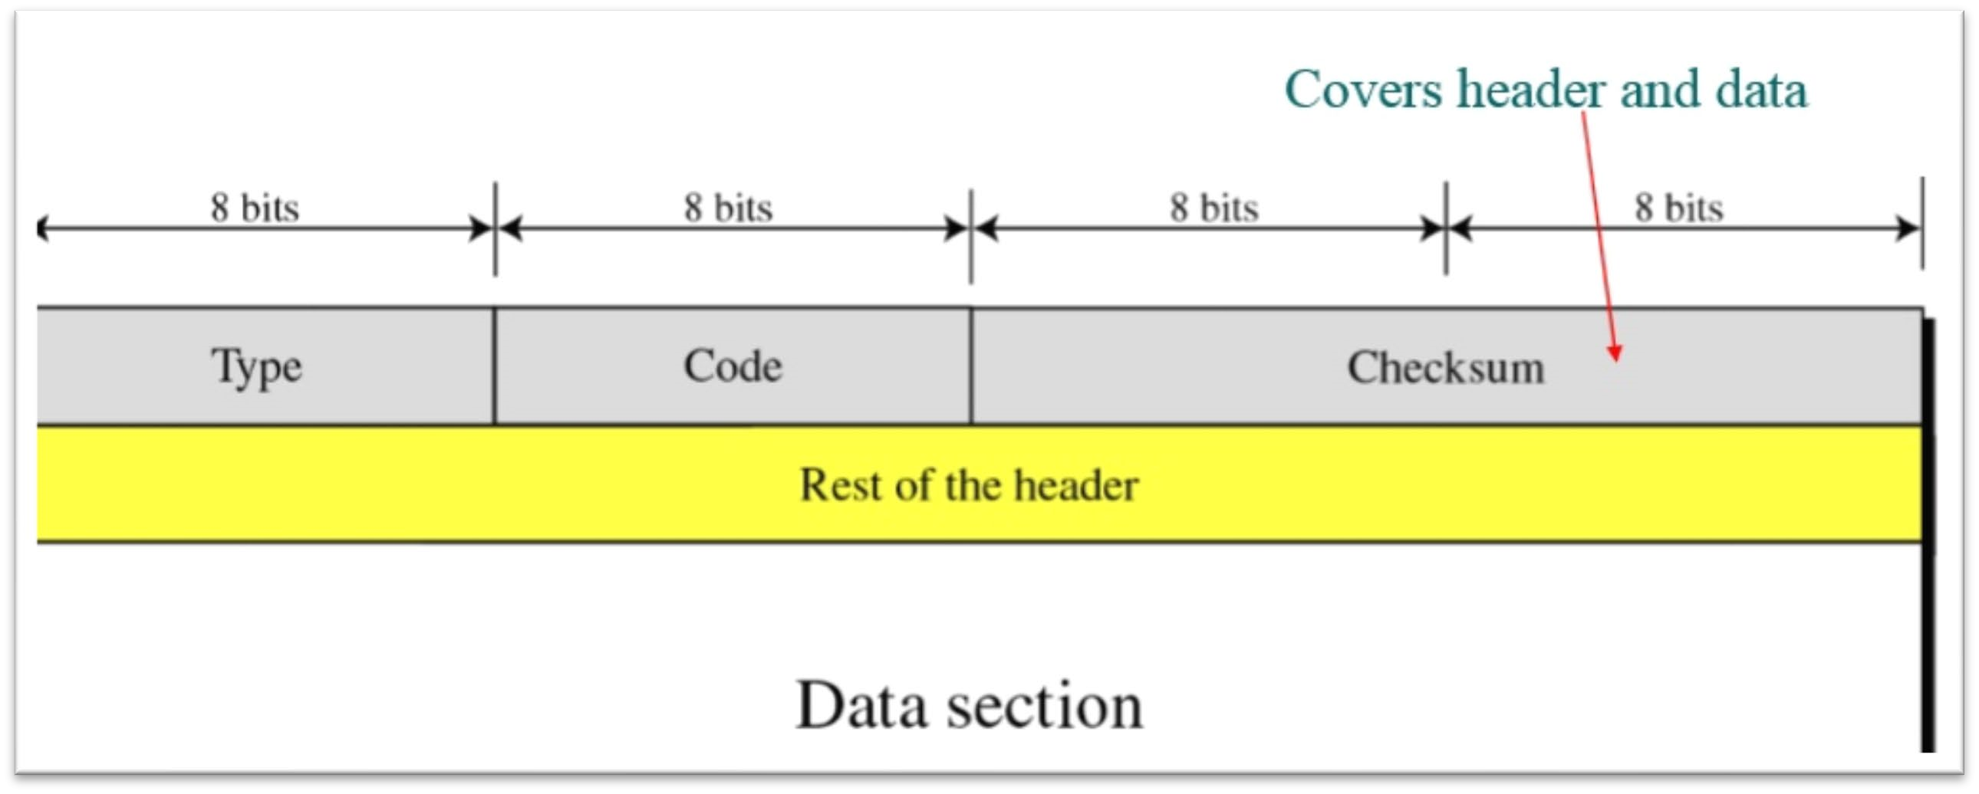

ICMP Format

Slide 5
ICMP Message Types
Types | Codes | Description
0 | 0 | echo reply (ping)
3 | 0 | dest network unreachable
3 | 1 | dest host unreachable
3 | 2 | dest protocol unreachable
3 | 3 | dest port unreachable
3 | 6 | dest network unknown
3 | 7 | dest host unknown
4 | 0 | source quench (congestion control)
8 | 0 | echo request (ping)
9 | 0 | route advertisement
10 | 0 | router discovery
11 | 0 | TTL expired
12 | 0 | Parameter unintelligible
13 | 0 | timestamp
14 | 0 | timestamp reply
15 | 0 | address mask request
16 | 0 | address mask reply
ICMP Messages
Request/Reply
Echo request/reply
Timestamp request/reply
Assress mask request/reply
Router discovery/advertisement
Error Reports
Destination unreachable
Source quench (congestion control)
Parameters problem
Redirection
Task 1
Task 2

Slide 6
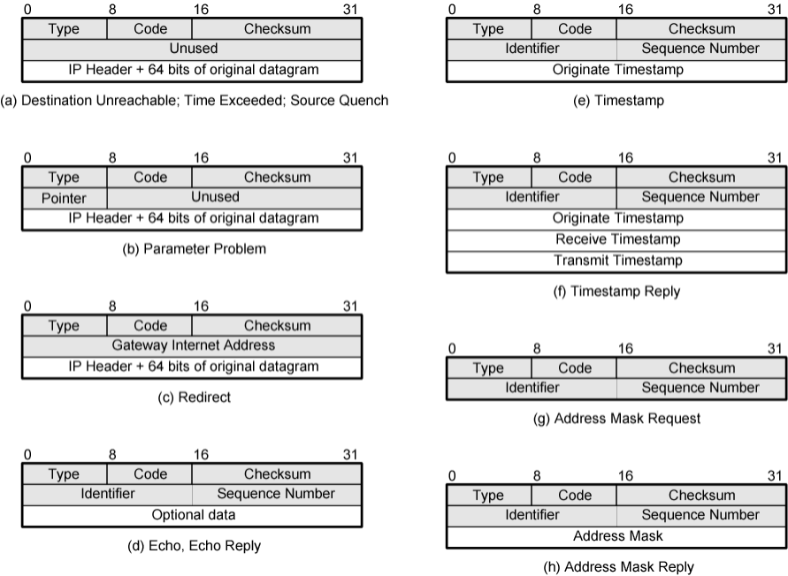
ICMP Formats
Task 2
Task 1

Slide 7
Respond to ICMP
Procedure
Construct ICMP and IP header
Details of ICMP formats and types in the previous slides
Send the ICMP message
Reuse the forwarding method in lab 4
DDL:5/19/2020

Slide 8
Q & A

